Slide 1
Optimizing Program Performance
60080013: Computer Organization
5th Lecture, 2022
Chapter2: 20points
Chapter3: 8points
Chapter4: 24points
Chapter5: 25points
Chapter6:
4种有效：①②循环体中少用指针③循环展开与多路结合④循环展开与结合律
Instructors:
Sun Heng
2种无效：①减少函数调用次数②单纯使用循环展开
Notes:
*

Slide 2
Performance Realities
Today, there are many occasions when making a program run fast is an important consideration. If a program must process video frames or network packets in real time, then a slow-running program will not provide the needed functionality. When a computation task is so demanding that it requires days or weeks to execute, then making it run just 20% faster can have significant impact. In this chapter, we will explore how to make programs run faster via several different types of program optimization.

Slide 3
Optimizing Activities
Select an appropriate set of algorithms and data structures
Understand the capabilities and limitations of optimizing compilers
Divide a task into portions that can be computed in parallel

Slide 4
Limitations of Optimizing Compilers
Compilers must be careful to apply only safe optimizations to a program, meaning that the resulting program will have the exact same behavior as would an unoptimized version for all possible cases the program may encounter, up to the limits of the guarantees provided by the C language standards. Constraining the compiler to perform only safe optimizations eliminates possible sources of undesired run-time behavior, but it also means that the programmer must make more of an effort to write programs in a way that the compiler can then transform into efficient machine-level code.

Slide 5
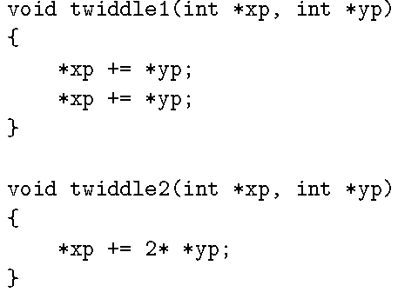
Limitations of Optimizing Compilers
To appreciate the challenges of deciding which program transformations are safe or not, consider the following two procedures:

Slide 6

Limitations of Optimizing Compilers
Consider, however, the case in which xp and yp are equal. Then function twiddle1 will perform the following computations:
The result will be that the value at xp will be increased by a factor of 4. On the other hand, function twiddle2 will perform the following computation:
The result will be that the value at xp will be increased by a factor of 3.

Slide 7
Optimization Blocker: Memory Aliasing
Aliasing
  Two different memory references specify single location
  Easy to have happen in C
    Since allowed to do address arithmetic
    Direct access to storage structures
  Get in habit of introducing local variables
    Accumulating within loops
    Your way of telling compiler not to check for aliasing

Slide 8
Expressing Program Performance
We introduce the metric cycles per element, abbreviated “CPE,” as a way to express program performance in a way that can guide us in improving the code.
CPE measurements help us understand the loop performance of an iterative program at a detailed level.
-fno-strict-aliasing

Slide 9
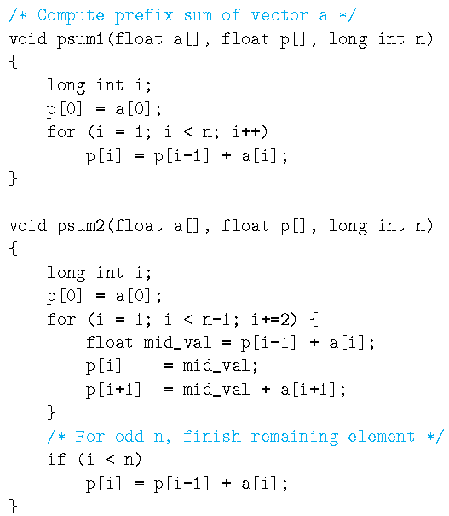


CPE
Loop unrolling
Many procedures contain a loop that iterates over a set of elements. For example, functions psum1 and psum2:
Functions psum1 and psum2 both compute the prefix sum of a vector of length n.
For a vector:
the prefix sum:
is defined as:

Slide 10
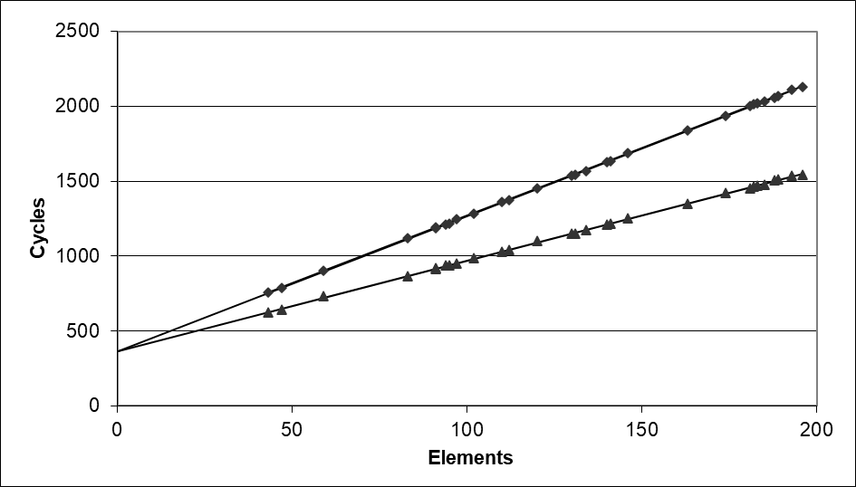
CPE
是一种用于衡量算法或程序的执行效率的指标
The time required by the two procedures can be characterized as a constant plus a factor proportional to the number of elements processed.
Using a least squares fit, we find that the run times (in clock cycles) for psum1 and psum2 can be approximated by the equations 368 + 9.0n and 368 + 6.0n, respectively.
We refer to the coefficients in these terms as the effective number of cycles per element, abbreviated “CPE.” We prefer measuring the number of cycles per element rather than the number of cycles per iteration. By this measure, psum2, with a CPE of 6.0, is superior to psum1, with a CPE of 9.0.
psum1
Slope = 9.0
psum2
Slope = 6.0

Slide 11
Benchmark Example: Data Type for Vectors
/* data structure for vectors */
typedef struct{
int len;
data_t *data;
} vec;
len
0
1
len-1
data
/* retrieve vector element and store at val */
double get_vec_element(*vec, idx, data_t *val)
{
if (idx < 0 || idx >= vec->len)
return 0;
*val = vec->data[idx];
return 1;
}

Slide 12
Benchmark Computation
void combine1(vec_ptr v, data_t *dest)
{
long int i;
*dest = IDENT;
for (i = 0; i < vec_length(v); i++) {
data_t val;
get_vec_element(v, i, &val);
*dest = *dest OP val;
}
}
Compute sum or product of vector elements
OP:作为操作符，只能定义为加法or乘法，对应的IDENT将初始化为0or1
Data Types
  Use different declarations for data_t
  int
  long
  float
  double
Operations
  Use different definitions of OP and IDENT
  + / 0
  * / 1

Slide 13

Benchmark Performance
void combine1(vec_ptr v, data_t *dest)
{
long int i;
*dest = IDENT;
for (i = 0; i < vec_length(v); i++) {
data_t val;
get_vec_element(v, i, &val);
*dest = *dest OP val;
}
}
Compute sum or product of vector elements
自动优化 gcc –o1
Method | Integer |  | Double FP
Operation | Add | Mult | Add | Mult
Combine1 unoptimized | 22.68 | 20.02 | 19.98 | 20.18
Combine1 –O1 | 10.12 | 10.12 | 10.17 | 11.14
Results in CPE (cycles per element)

Slide 14
Eliminating Loop Inefficiencies
void combine2(vec_ptr v, data_t *dest)
{
long int i;
long int length = vec_length(v);
*dest = IDENT;
for (i = 0; i < length; i++) {
data_t val;
get_vec_element(v, i, &val);
*dest = *dest OP val;
}
}
要保存到寄存器当中，不要赋给指针，指针在内存当中，导致每次程序进行都要访问以此内存，导致效能变差。
Method | Integer |  | Double FP
Operation | Add | Mult | Add | Mult
Combine1 | 10.12 | 10.12 | 10.17 | 11.14
Combine2 | 7.02 | 9.03 | 9.02 | 11.03
Results in CPE (cycles per element)

Slide 15

Reducing Procedure Calls
void combine3(vec_ptr v, data_t *dest)
{
long int i;
long int length = vec_length(v);
data_t *data = get_vec_start(v);
*dest = IDENT;
for (i = 0; i < length; i++) {
*dest = *dest OP data[i];
}
}
增加了内存的调用
无效优化：减少函数的使用次数。
Method | Integer |  | Double FP
Operation | Add | Mult | Add | Mult
Combine2 | 7.02 | 9.03 | 9.02 | 11.03
Combine3 | 7.17 | 9.02 | 9.02 | 11.03
Results in CPE (cycles per element)

Slide 16
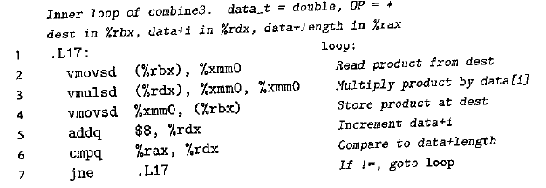
Eliminating Unneeded Memory References
The x86-64 code generated for data type double and with multiplication as the combining :

Slide 17
Eliminating Unneeded Memory References
void combine4(vec_ptr v, data_t *dest)
{
int i;
int length = vec_length(v);
data_t *d = get_vec_start(v);
data_t acc = IDENT;
for (i = 0; i < length; i++)
acc = acc OP d[i];
*dest = acc;
}
Method | Integer |  | Double FP
Operation | Add | Mult | Add | Mult
Combine3 | 7.17 | 9.02 | 9.02 | 11.03
Combine4 | 1.27 | 3.01 | 3.01 | 5.01
With this final transformation, we reached a point where we require just 1.2–5 clock cycles for each element to be computed. This is a considerable improvement over the original 10–11 cycles when we first enabled optimization.

Slide 18

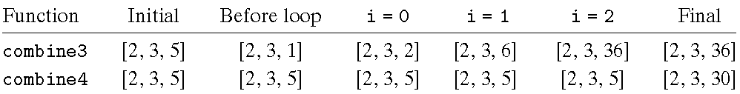
Combine3 vs. Combine4
Consider, the case of integer data with multiplication as the operation and 1 as the identity element. Let v = [2, 3, 5] be a vector of three elements and consider the following two function calls:
That is, we create an alias between the last element of the vector and the destination for storing the result. The two functions would then execute as follows:
combine3 accumulates its result at the destination, which in this case is the final vector element. This value is therefore set first to 1, then to 2× 1= 2, and then to 3×2 = 6. On the final iteration, this value is then multiplied by itself to yield a final value of 36. For the case of combine4, the vector remains unchanged until the end, when the final element is set to the computed result 1×2×3×5 = 30.

Slide 19
Modern CPU Design
常规：数据结构优化
难：应用硬件提高性能
Instruction Control
Fetch
Control
Address
Instruction
Cache
Retirement
Unit
Register
File
Instruction
Decode
Instructions
Operations
Register Updates
Prediction OK?
Execution
Functional
Units
Branch
Arith
Arith
Arith
Load
Store
Operation Results
Addr.
Addr.
重要：只有一个load unit 并且一次只能取出两组数据
Data
Data
Data
Cache

Slide 20
Superscalar Processor
Definition: A superscalar processor can issue and execute multiple instructions in one cycle. The instructions are retrieved from a sequential instruction stream and are usually scheduled dynamically.
Benefit: without programming effort, superscalar processor can take advantage of the instruction level parallelism that most programs have
Most modern CPUs are superscalar.
Intel: since Pentium (1993)

Slide 21
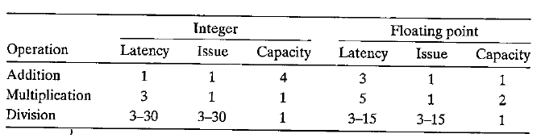
Functional Unit Performance
延迟时间：一个指令的最小执行时间
度量了优化的目标：latency优化和issue time优化→issue time 充分利用了硬件特性
Latency: the total time required to perform the operation
Issue time: the minimum number of clock cycles between two successive operations of the same type
Capacity: the number of functional units capable of performing that operation
Throughput: the reciprocal of the issue time
两个操作之间间隔的时间，通常比latency要小。相同类型的指令同时进来。

Slide 22


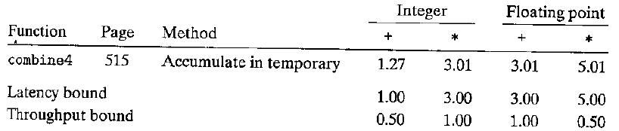


Two Fundamental Bounds on the CPE Values
串行
Latency bound: a minimum value for the CPE for any function that must perform the combining operation in a strict sequence.
Throughput bound: a minimum bound for the CPE based on the maximum rate at which the functional units can produce results.
并行
只能是0.5是因为load unit一次只能读取两个数据

Slide 23
Abstract Model of Processor Operation
重要：考试可能会考画图+分析 10-12分
Data-flow representation: a graphical notation showing how the data dependencies between the different operations constrain the order in which they are executed.
Critical paths: a lower bound on the number of clock cycles required to execute a set of machine instructions.

Slide 24
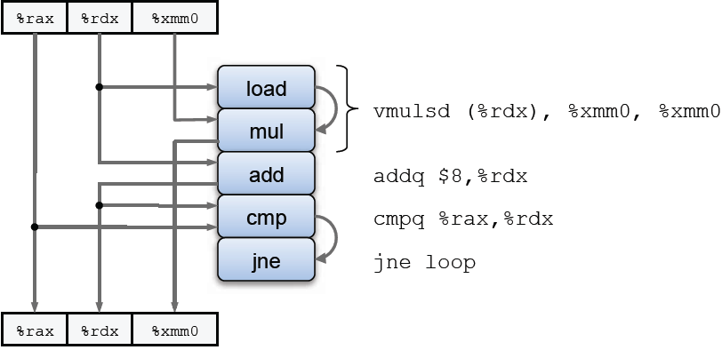
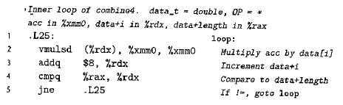
From Machine-Level Code to Data-Flow Graphs
void combine4(vec_ptr v, data_t *dest)
{
int i;
int length = vec_length(v);
data_t *d = get_vec_start(v);
data_t acc = IDENT;
for (i = 0; i < length; i++)
acc = acc OP d[i];
*dest = acc;
}

Slide 25
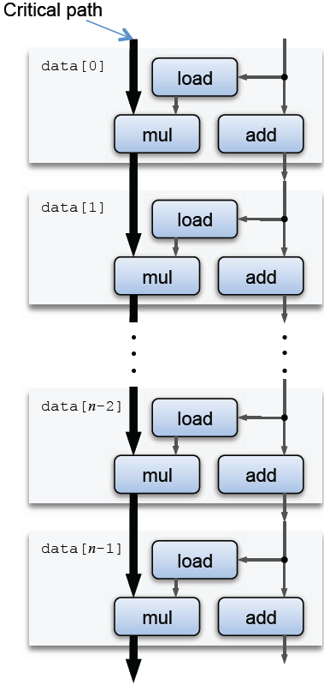
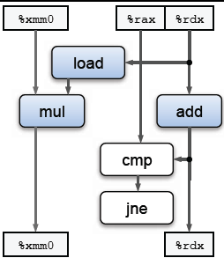
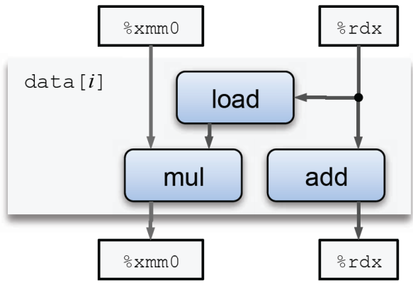
From Machine-Level Code to Data-Flow Graphs

Slide 26
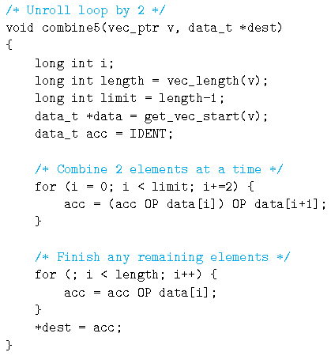
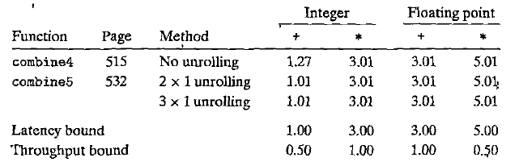
Loop Unrolling

Slide 27
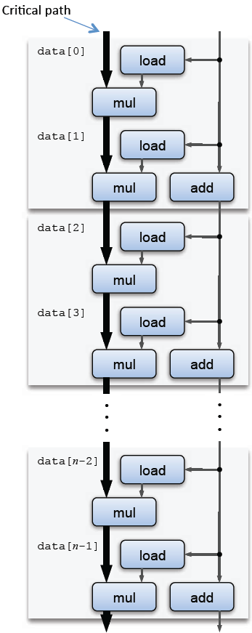
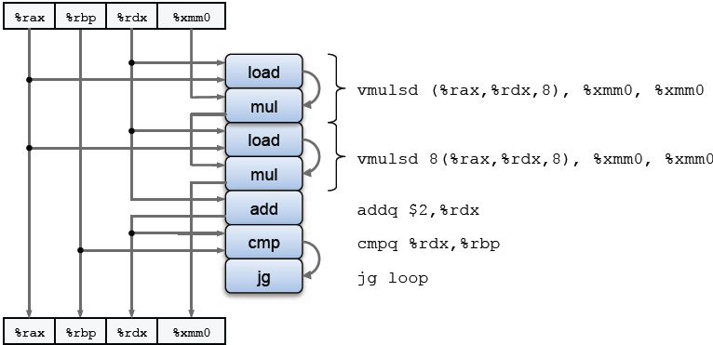
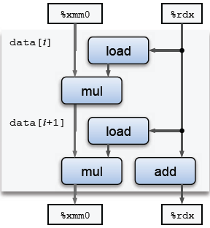
Loop Unrolling

Slide 28
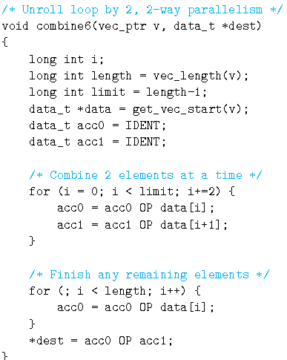
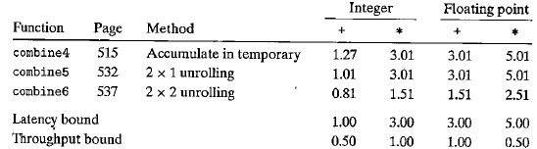
Enhancing Parallelism
多次多路展开能够有效优化

Slide 29
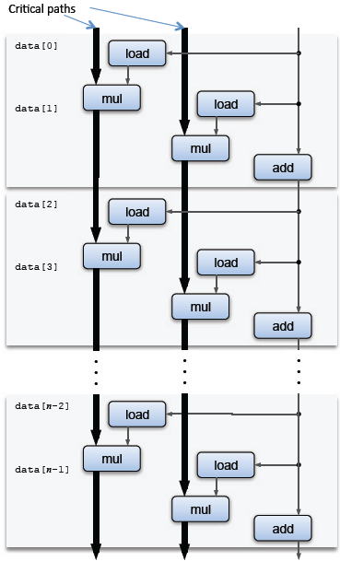
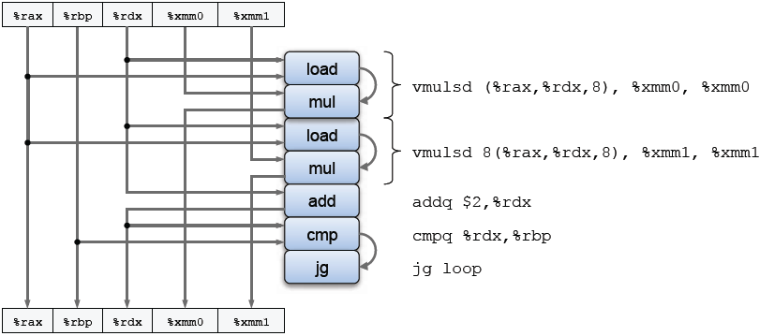
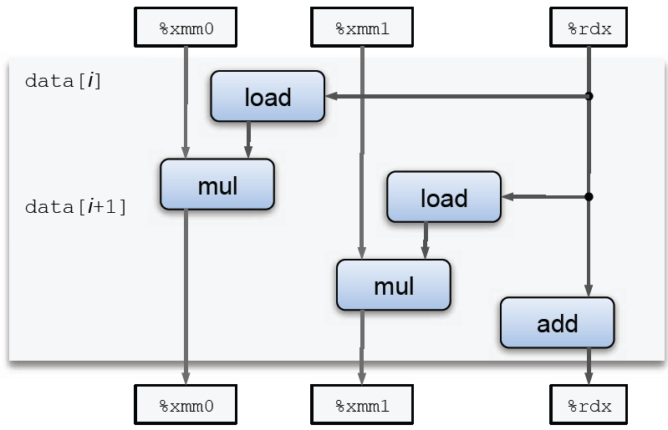
Enhancing Parallelism

Slide 30
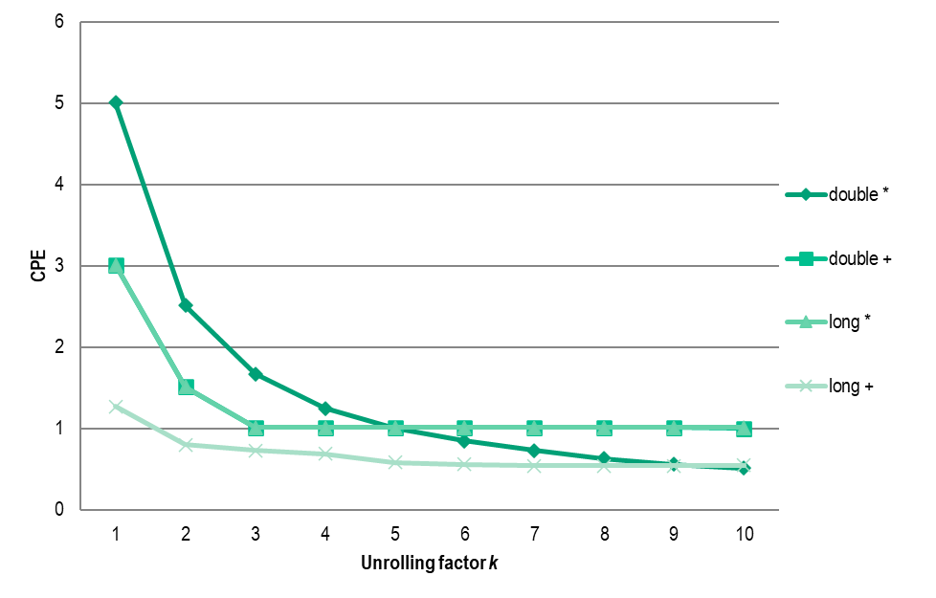
Enhancing Parallelism
K X K unrolling
 | 1 | 2 | 3 | 4 | 5 | 6 | 7 | 8 | 9 | 10
double * | 5.01 | 2.51 | 1.67 | 1.25 | 1 | 0.85 | 0.73 | 0.63 | 0.56 | 0.51
double + | 3.01 | 1.51 | 1.01 | 1.01 | 1.01 | 1.01 | 1.01 | 1.01 | 1.01 | 1
long * | 3.01 | 1.51 | 1.01 | 1.01 | 1.01 | 1.01 | 1.01 | 1.01 | 1.01 | 1.01
long + | 1.27 | 0.8 | 0.73 | 0.69 | 0.58 | 0.56 | 0.54 | 0.54 | 0.54 | 0.55

Slide 31
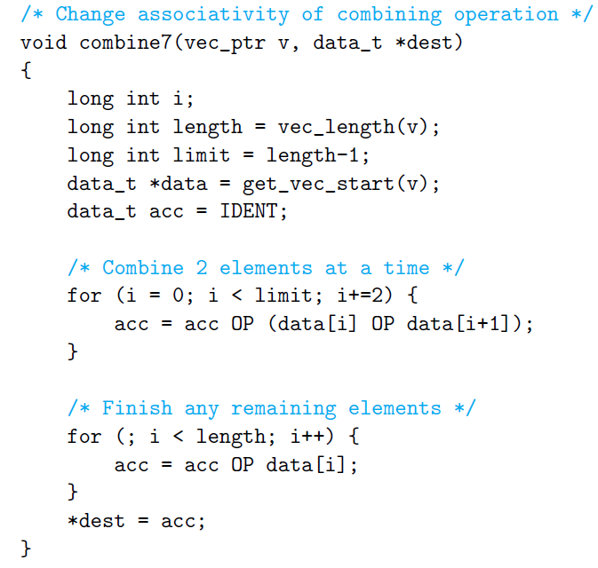
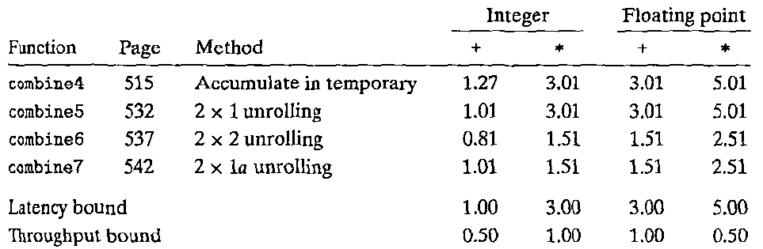
Reassociation Transformation
使用结合律进行优化

Slide 32
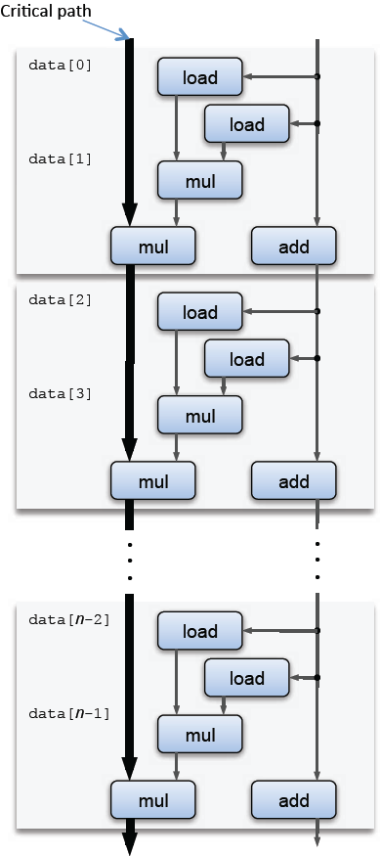

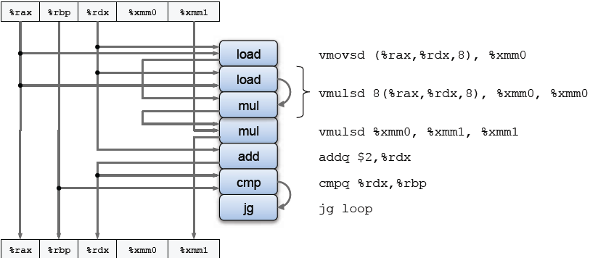
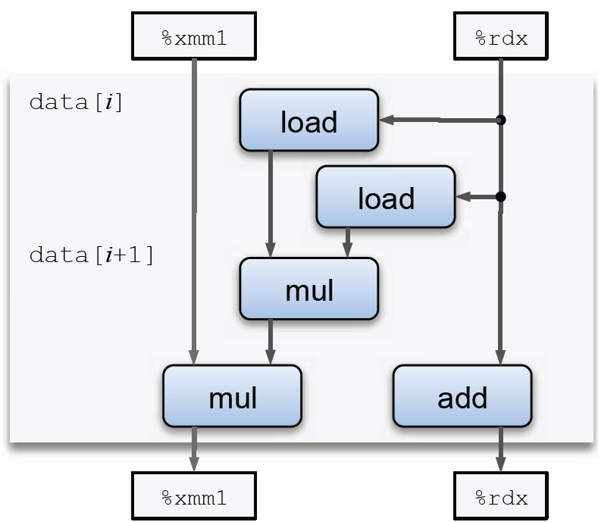
Reassociation Transformation
如何评判哪一个是关键路径呢？

Slide 33



Reassociation Transformation
K x unrolling, reassociate
 | 1 | 2 | 3 | 4 | 5 | 6 | 7 | 8 | 9 | 10
double * | 5.01 | 2.51 | 1.67 | 1.25 | 1 | 0.84 | 0.72 | 0.63 | 0.6 | 0.6
double + | 3.01 | 1.51 | 1.01 | 1.01 | 1.01 | 1.01 | 1.01 | 1.01 | 1 | 1.01
long * | 3.01 | 1.51 | 1 | 1.01 | 1.01 | 1.01 | 1.01 | 1.01 | 1.01 | 1.01
long + | 1.27 | 1.01 | 0.73 | 0.7 | 0.58 | 0.57 | 0.55 | 0.55 | 0.55 | 0.55

Slide 34
Classwork
Problem 5.3, 5.8, 5.15.
Notes:
*

